Slide 1
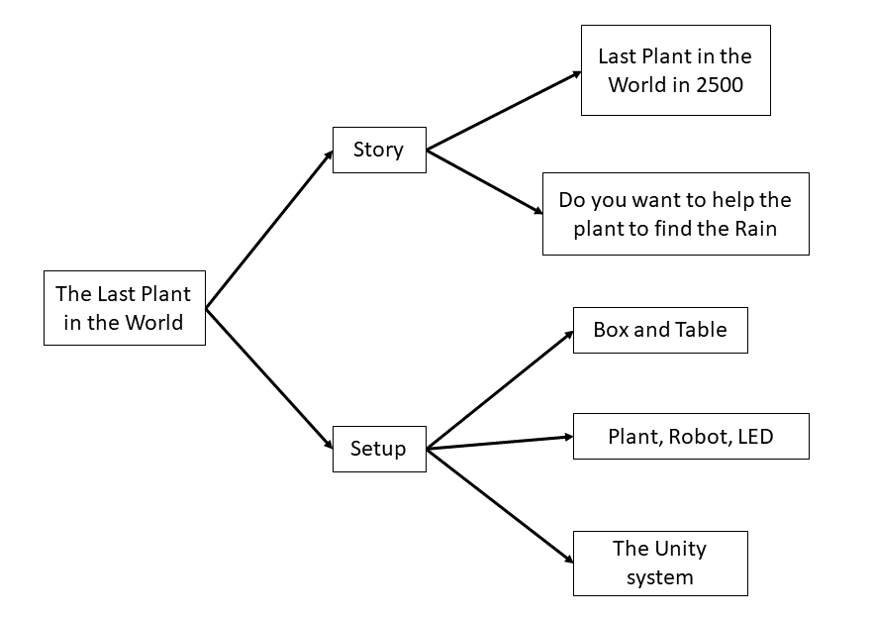
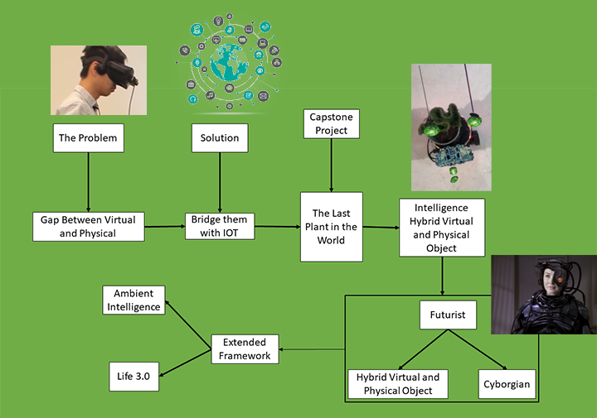
Motivation and Background
Project Goal
description
Story:
In 2500, there is a high civilization with many Cyborgian agents, and also there is no border between physical and virtual space. Organisms living in this world supported by the robotic body, and most of them are extinct since there are not enough resources in the world……
Now, you are in 2500. The last plant in the world is in front of you. It looses its’ way to the rain, would you like to guide it to the raining area to save its’ life?

Slide 2
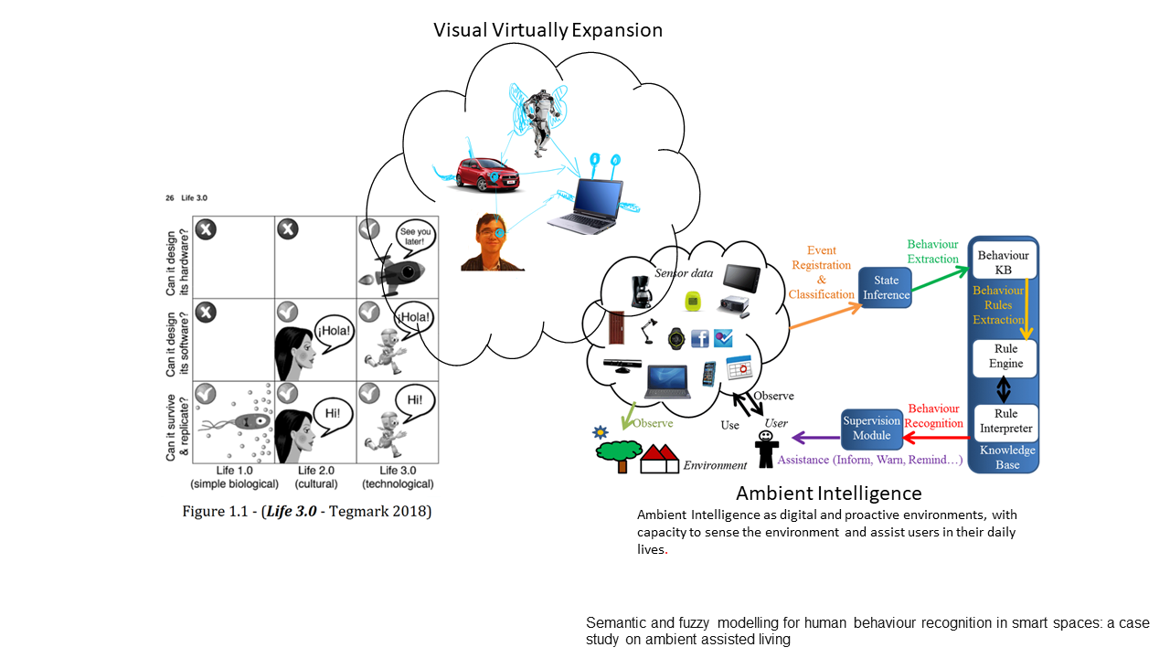
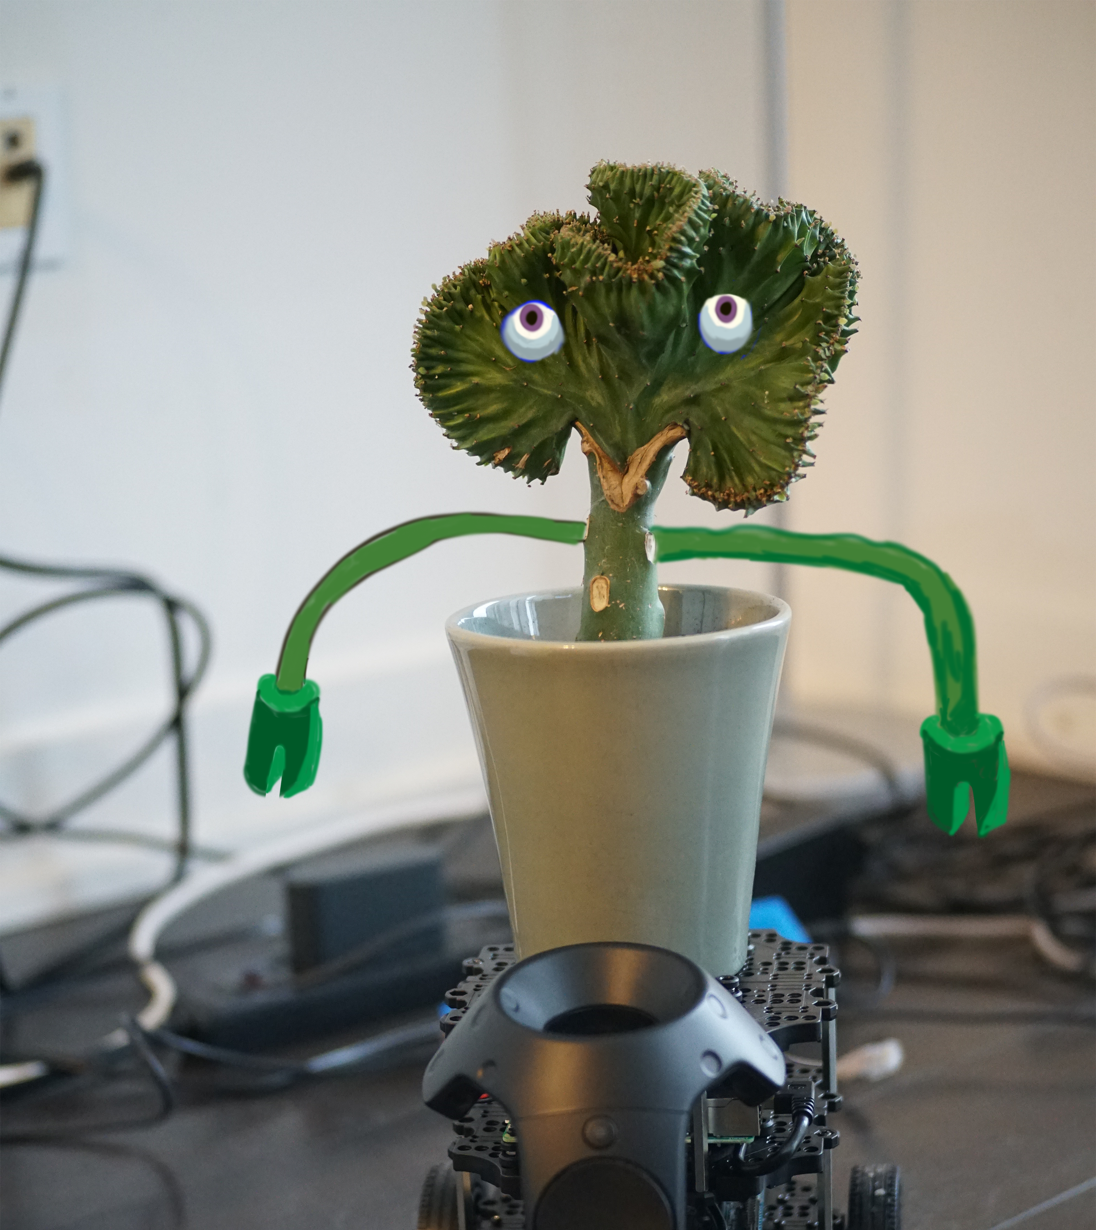
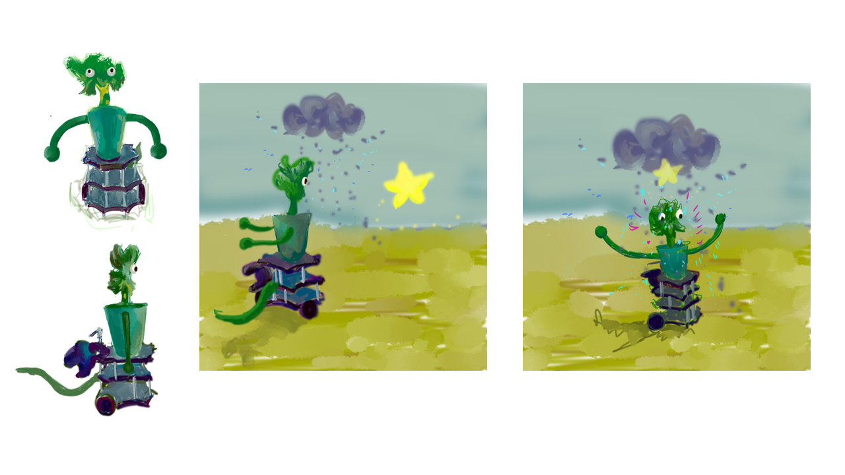
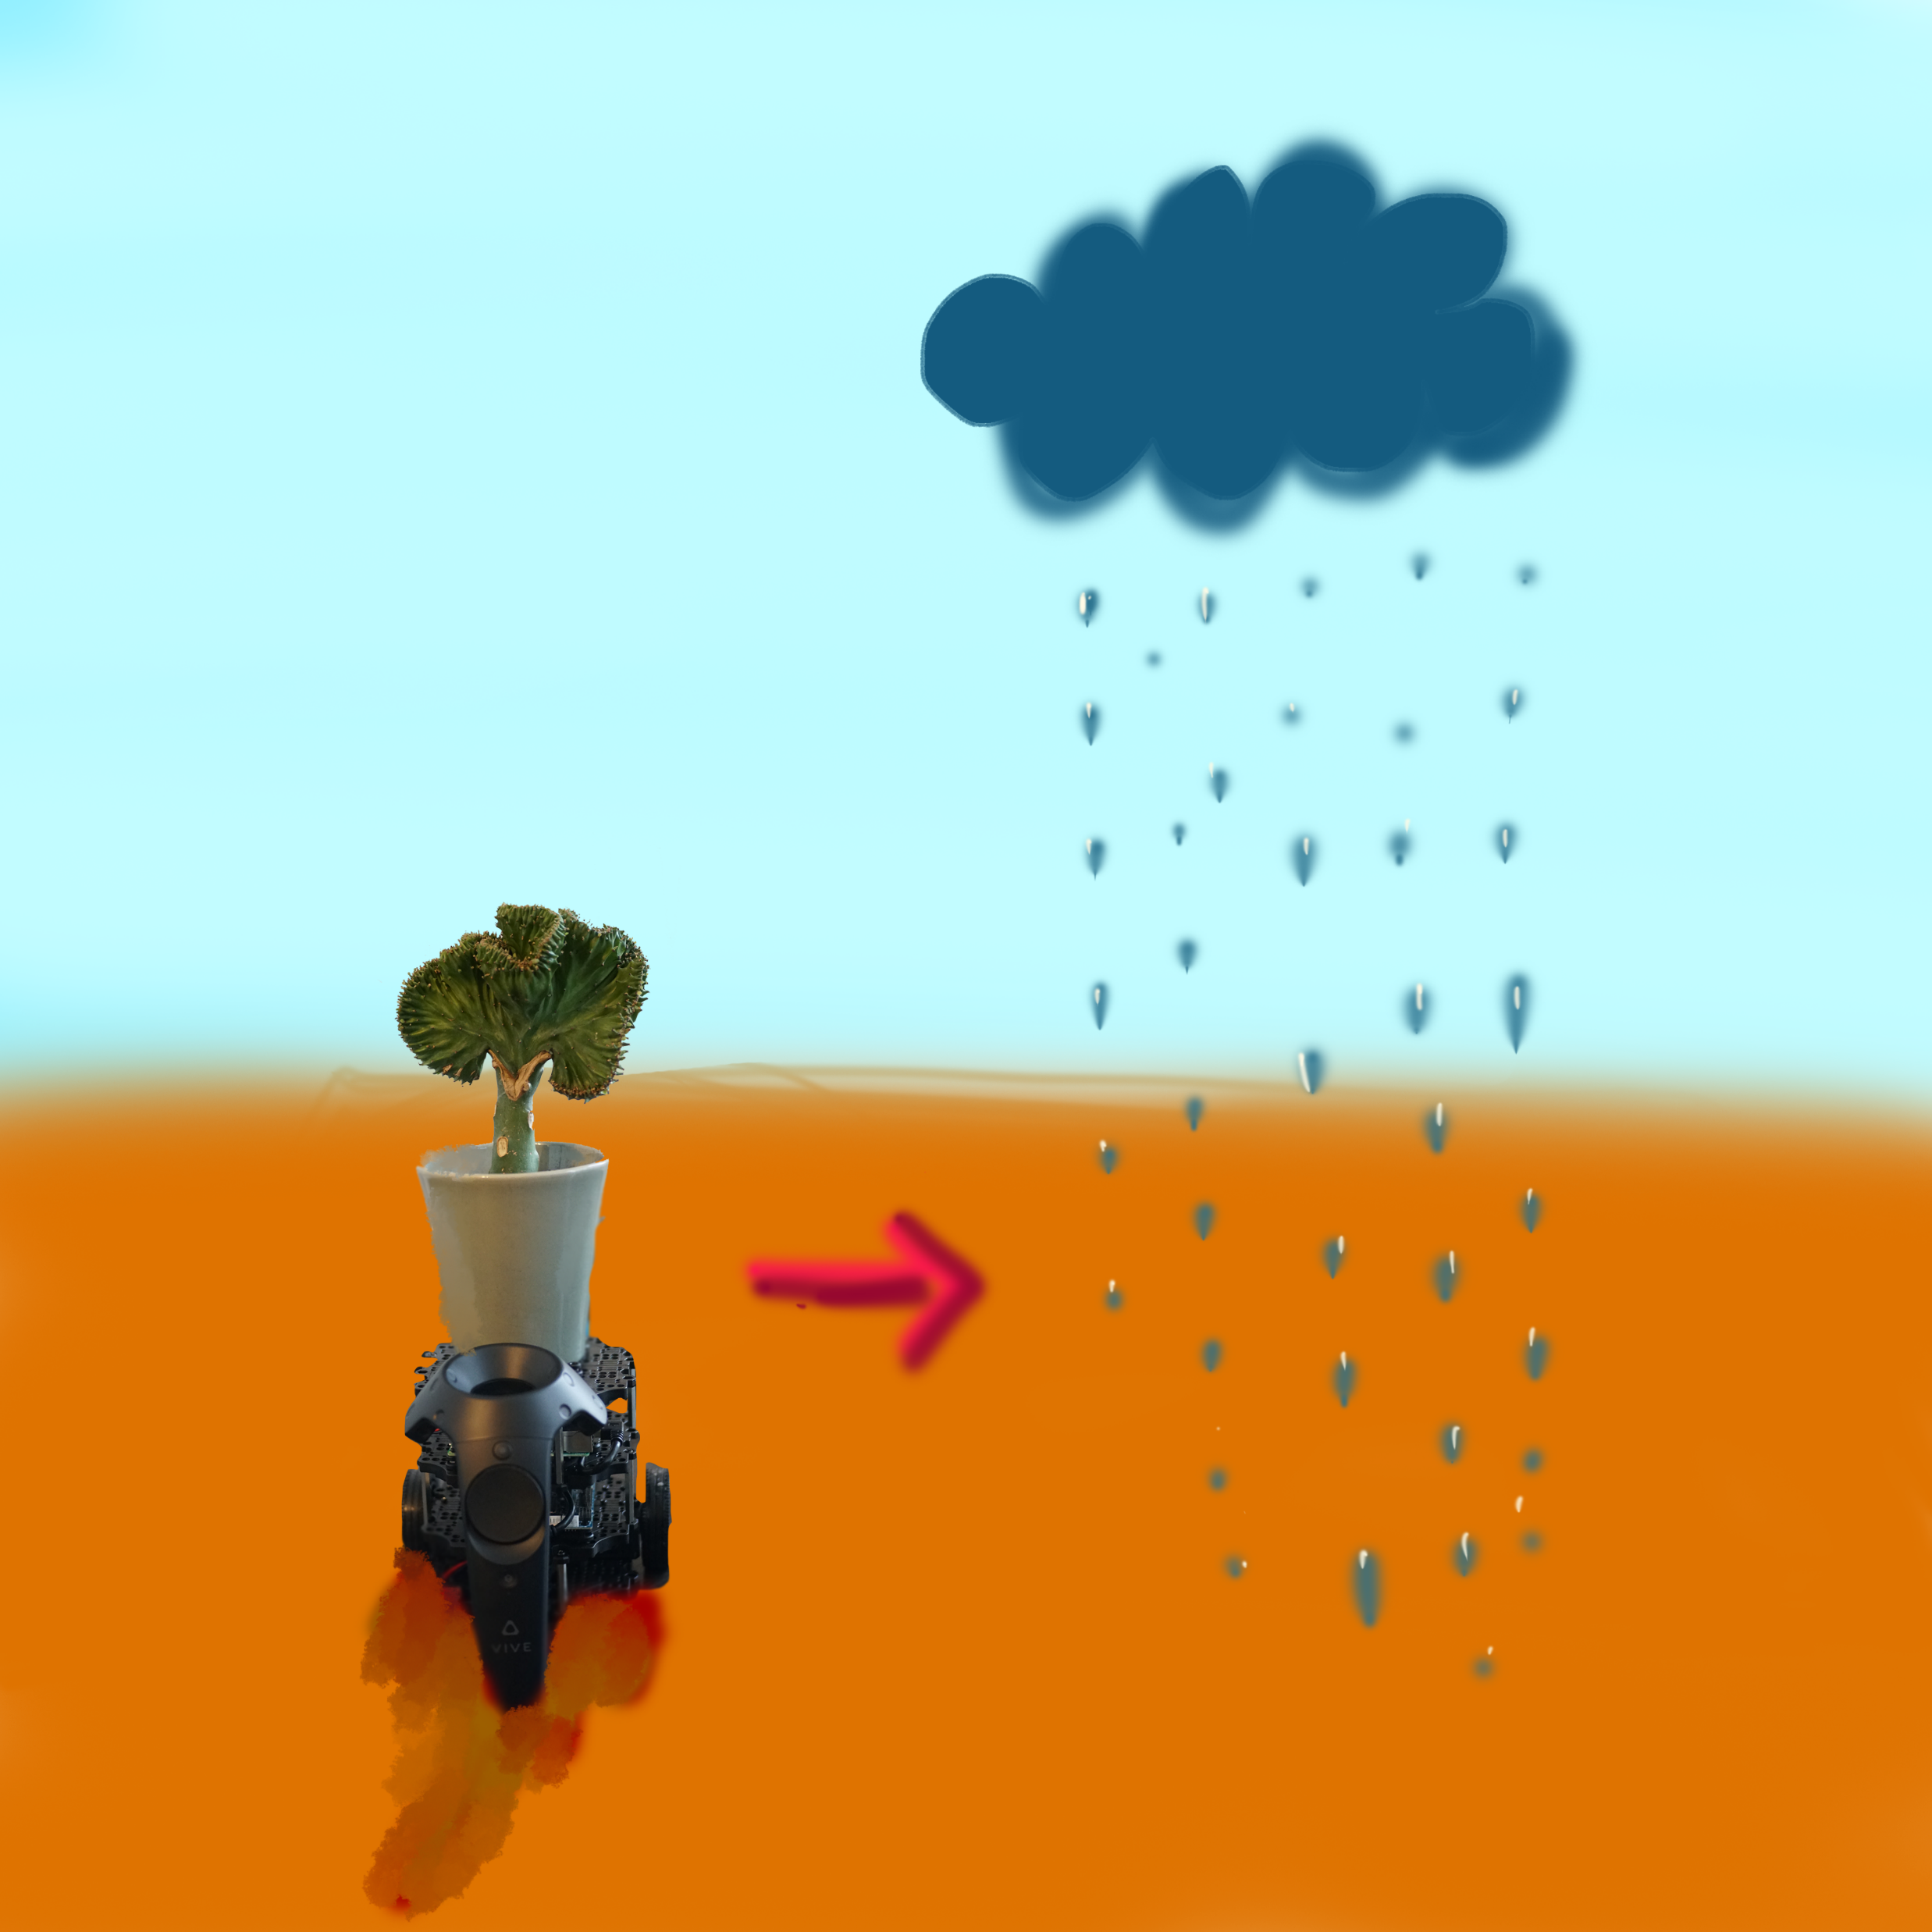
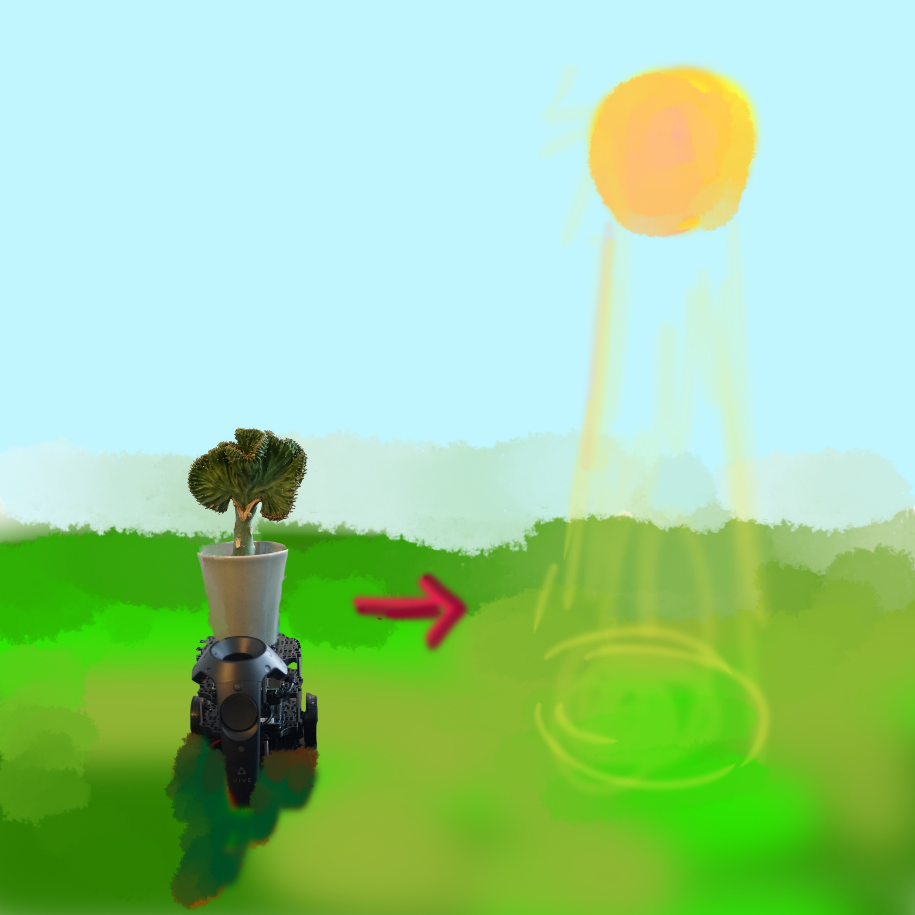
Concept Expansion with Brainstorm
Idea and Concept Generation
brainstorm
brainstorm

Slide 3
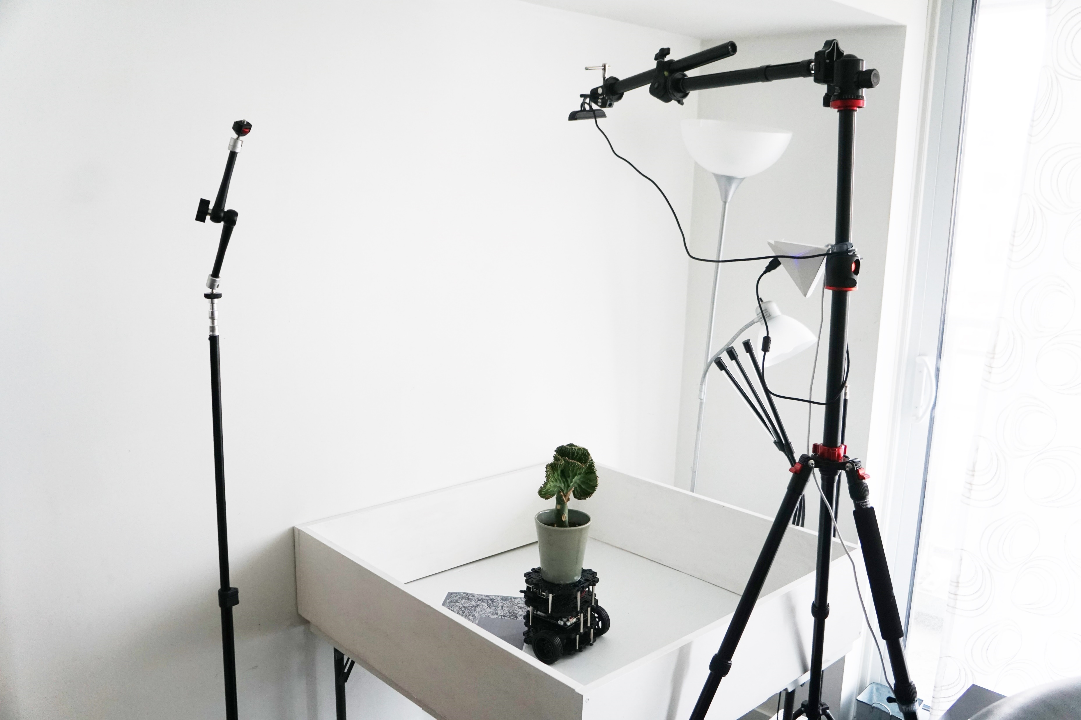
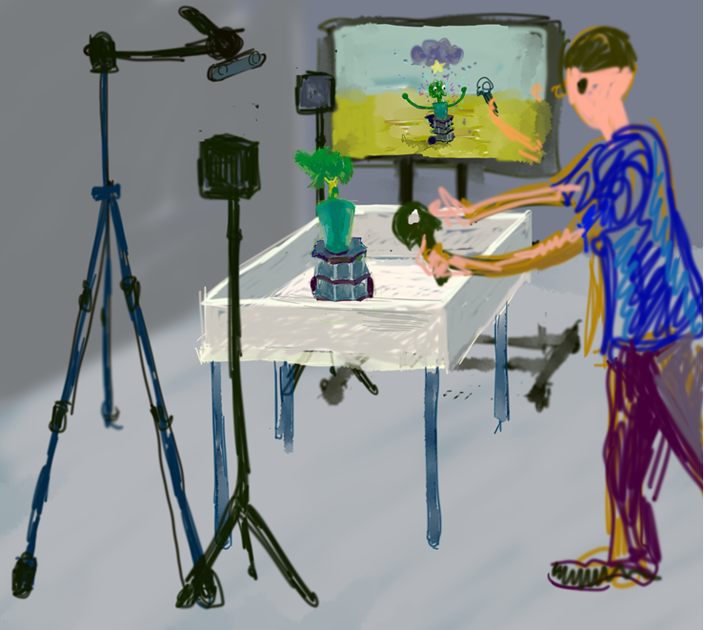
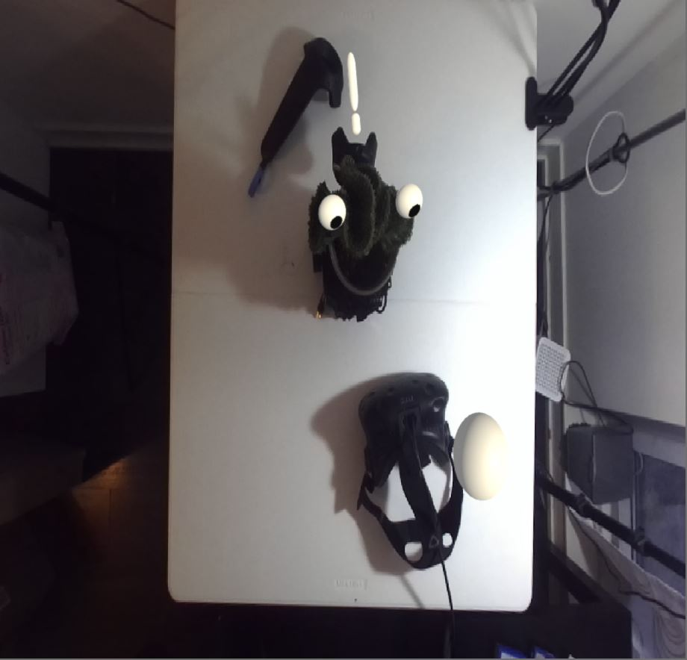
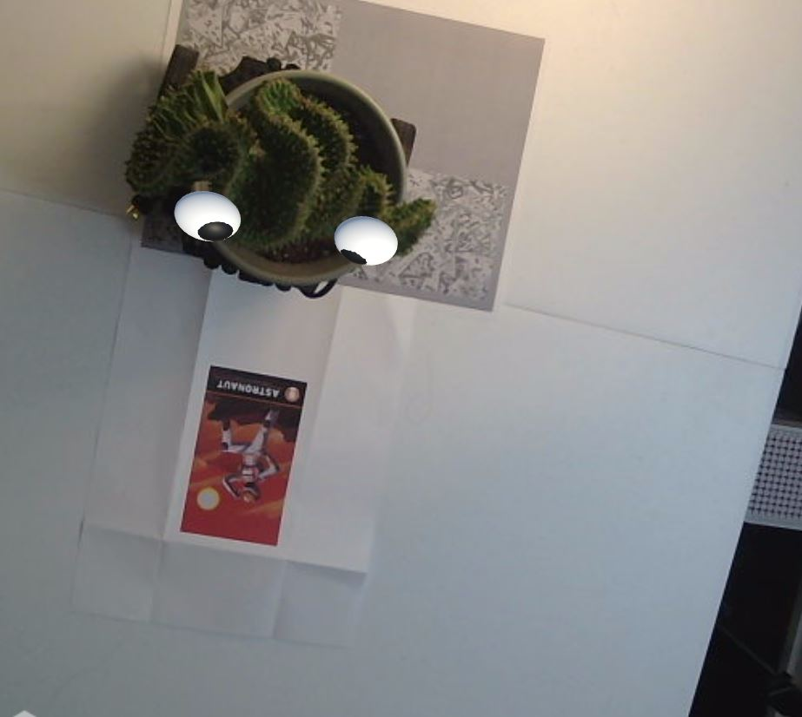
Plant Scenario
User Scenario
Prototype in Process

Slide 4
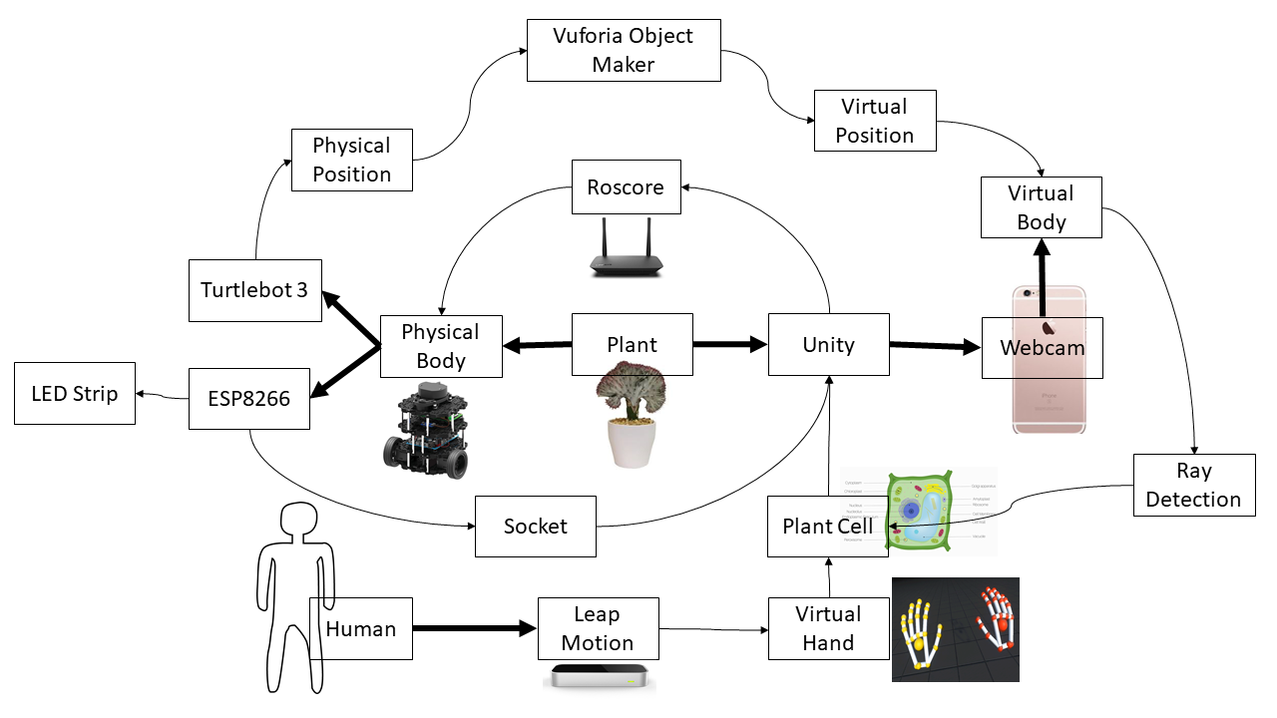
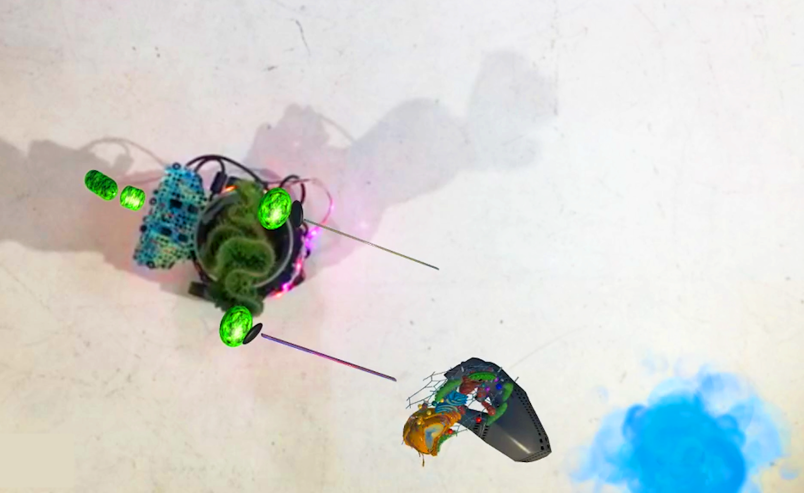
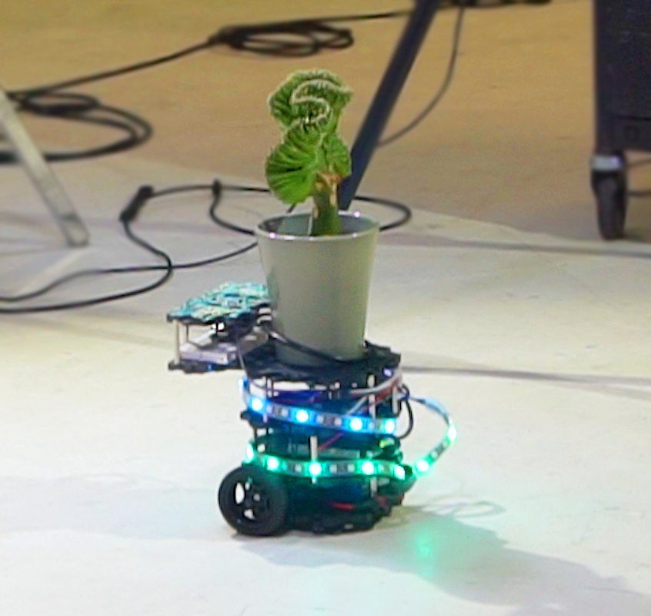
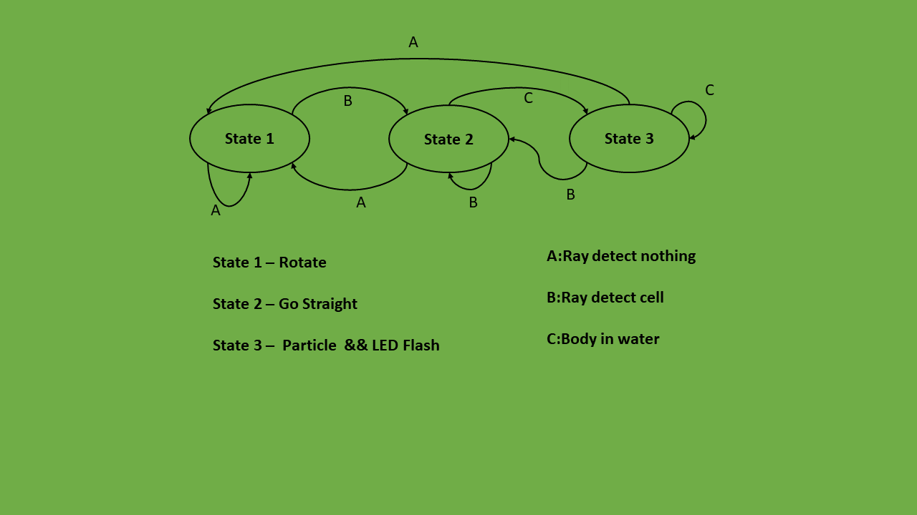
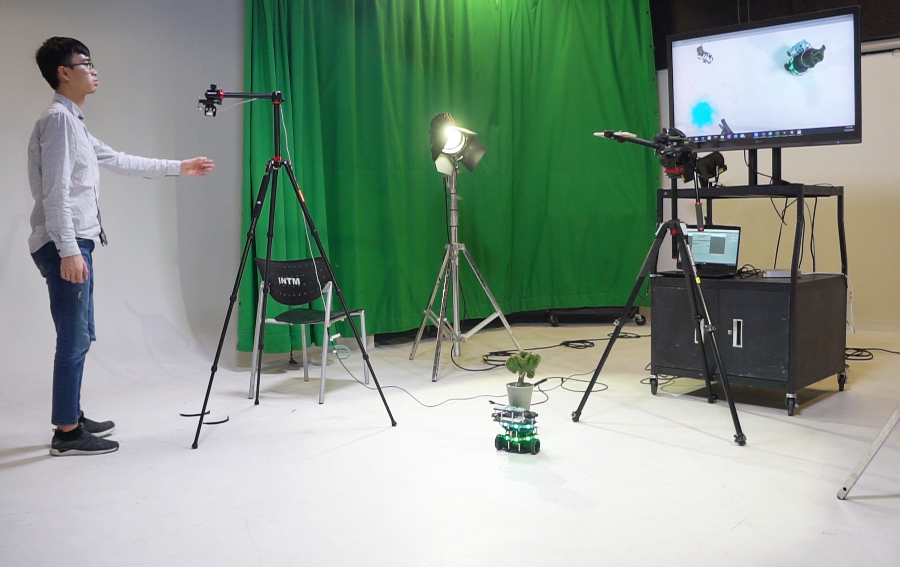
Data Architecture
The System and Connection

